Slide 1
Token Curated Ranking
Economically incentivized ranking

Slide 2
The goal
Create a truly decentralized consensus-driven tamperproof ranking of items (blockchain projects)

Slide 3
Solution
Economically incentivized token curated ranking

Slide 4
How it works?

Slide 5
Commit phase
Initiate voting for a project
Choose project X
Commit tokens
Predict this project to go ↑ or ↓ in ranking
Commit phase duration is specified

Slide 6
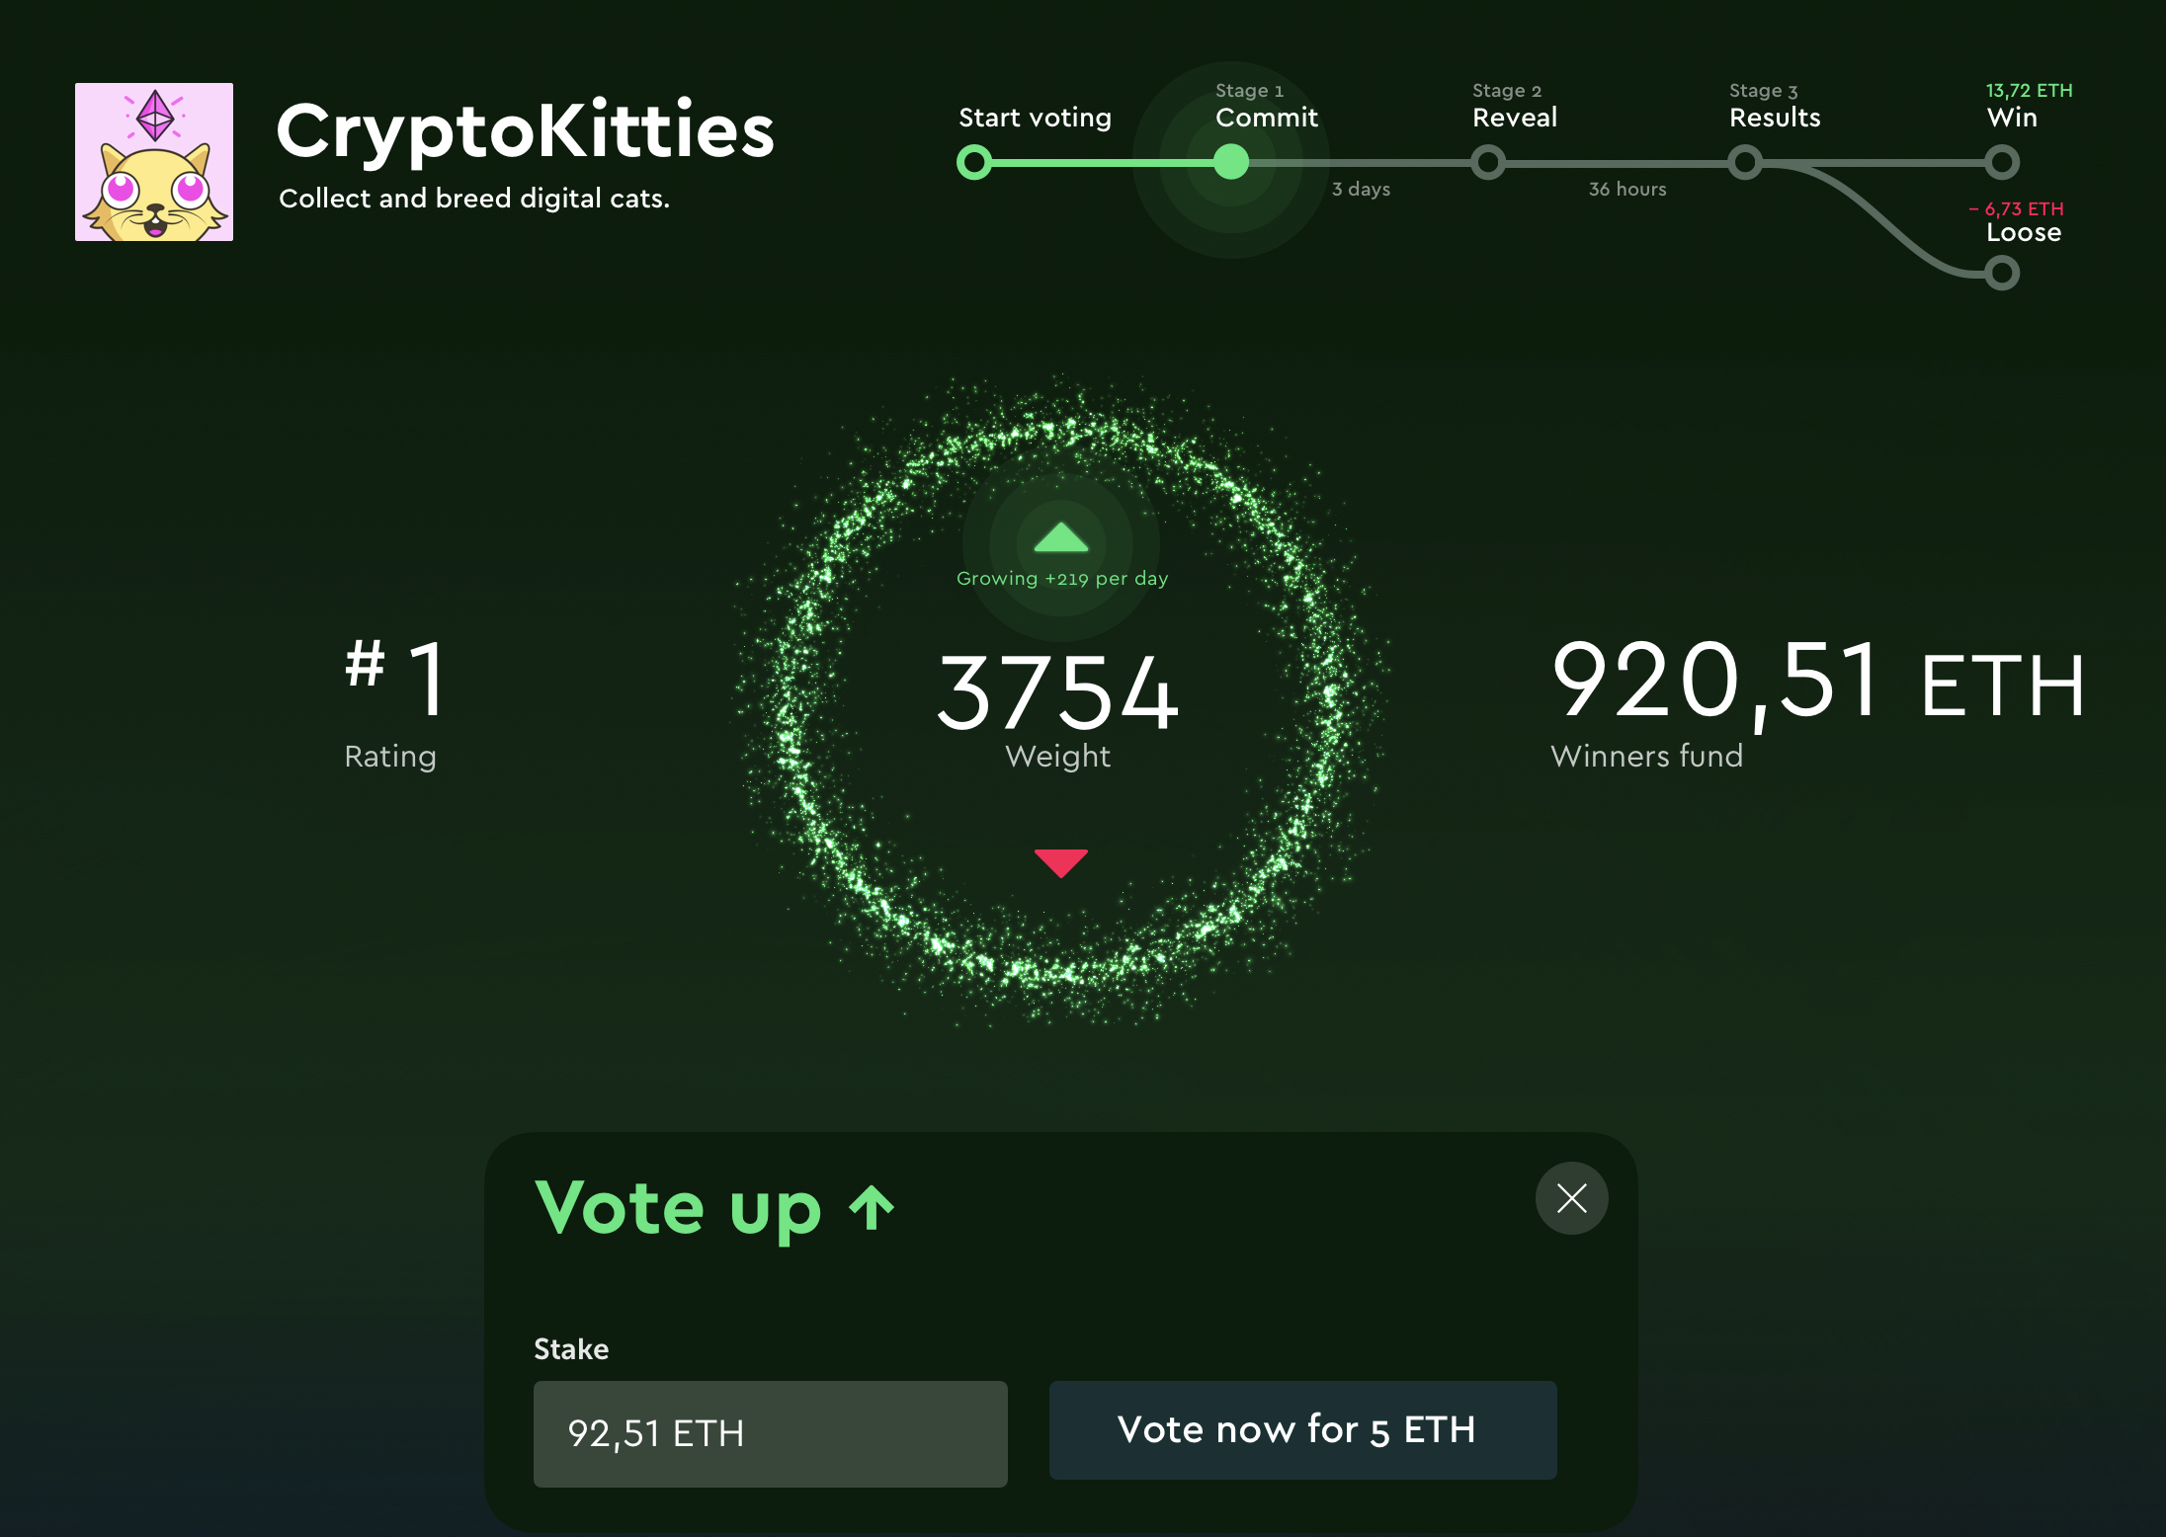
2. Voting phase
Other users cast their encrypted votes and stake tokens.
Commision is withheld.

Slide 7
3. Reveal phase
Everyone reveal their votes (↑ or ↓) and stake amount. Winning direction is determined.

Slide 8
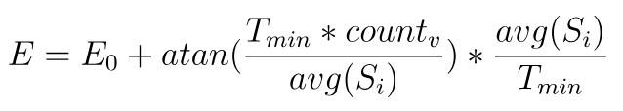
4. Movement phase
Final direction (↑ or ↓) is calculated based on overall stakes:
Minority voters get their stake back minus commision.
Majority voters get their stake plus commision over the period* of ranking position changing.
*Calculated as:
avg(S) = average of all stakes
Count_{v} = number of votes during last 24h

